Slide 1
UNESCO Chair/International Network of Water-Environment Centres for the Balkans (INWEB)
INWEB's contribution to the SDGs implementation process
Dr. Skoulikaris Charalampos (Haris),
hskoulik@civil.auth.gr
Thessaloniki, 31 October 2019

Slide 2
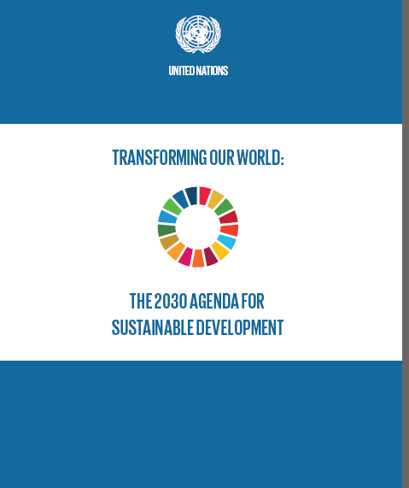
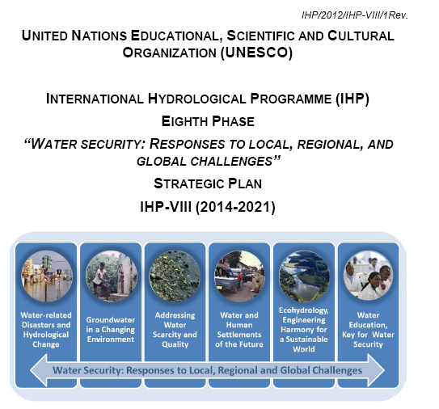
UNESCO is actively contributing to the implementation of the 2030 Agenda for Sustainable Development drawing on its humanist mandate, and mobilizing all of its partners and stakeholders

Slide 3
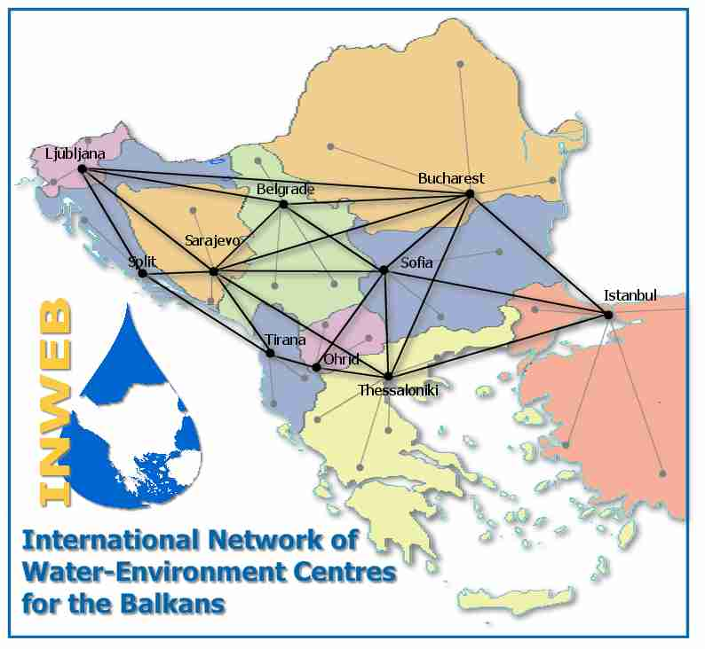
The UNESCO Chair/Network INWEB on “sustainable management of water and conflict resolution”
was established in July 2003 at the Aristotle University of Thessaloniki (AUTh), Department of Civil Engineering, Division of Hydraulics and Environmental Engineering.
Concentrating mainly on transboundary issues, INWEB encourages initiatives on water resources management issues from the bottom up, and promotes joint training projects and the sharing of expertise.
The UNESCO Chair/INWEB cooperates closely with UNESCO-IHP in Paris, UNESCO’s Regional Office for Science in Europe (UNESCO BRESCE) (Venice), as well as other major international organisations such as the United Nations Economic Commission for Europe (UNECE).

Slide 4
The educational and research activities of the UNESCO Chair & Network INWEB cover a wide range of scientific areas :
Facilitate the exchange of information in the fields of water and environment by establishing an international, open network in the Balkan region
Creation and maintenance of databases (cloud geo-information systems) on water and the environment related to transboundary water bodies (rivers, lakes, and coastal waters)
Mathematical modelling of hydrological and environmental phenomena
Environmental and hydrologic education
Climate change impacts on hydrology

Slide 5
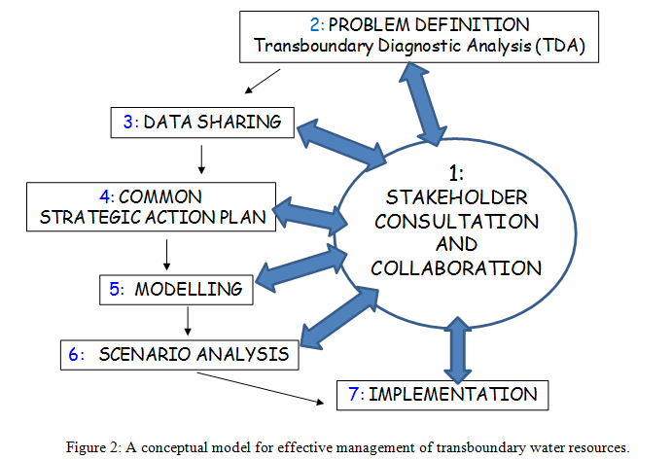
Transboundary Water Resources Management
THEME 2: GROUNDWATER IN A CHANGING ENVIRONMENT
Focal Area 2.5 – Promoting management of transboundary aquifers
Source: Ganoulis, J., Skoulikaris, Ch. (2011). A Conceptual Model for Implementing Integrated Transboundary Water Resources Management (ITWRM). Journal of Hydrologic Environment, 7(1), 155-158

Slide 6
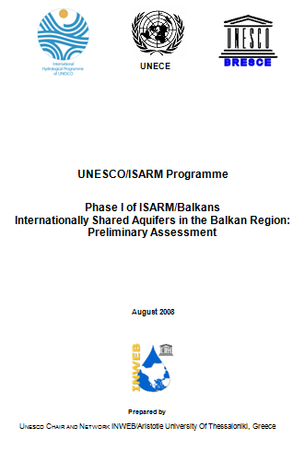
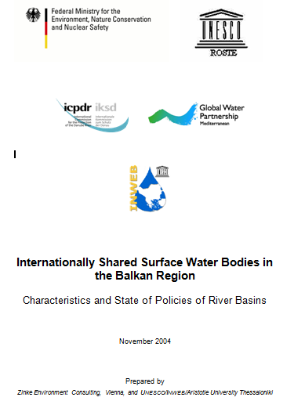
Integrated management of transboundary water bodies
Developed inventories of transboundary water

Slide 7
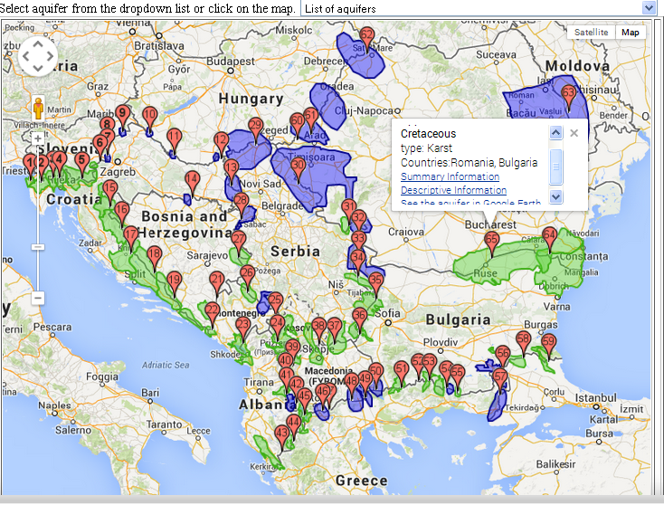
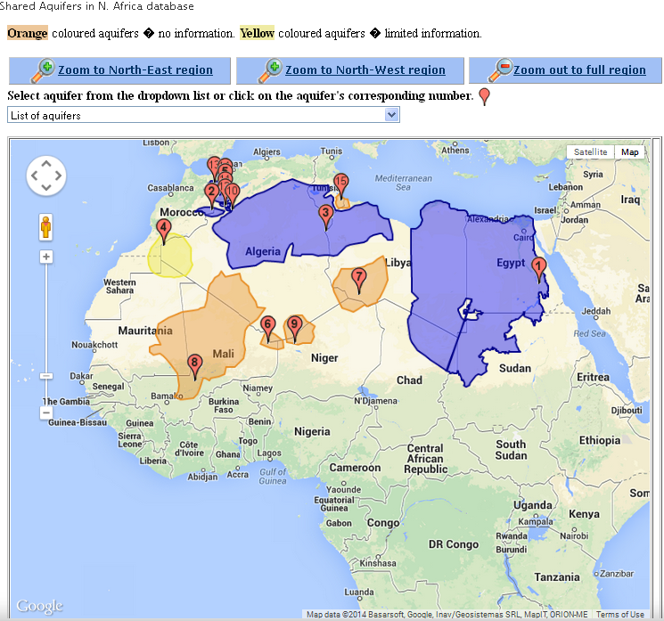
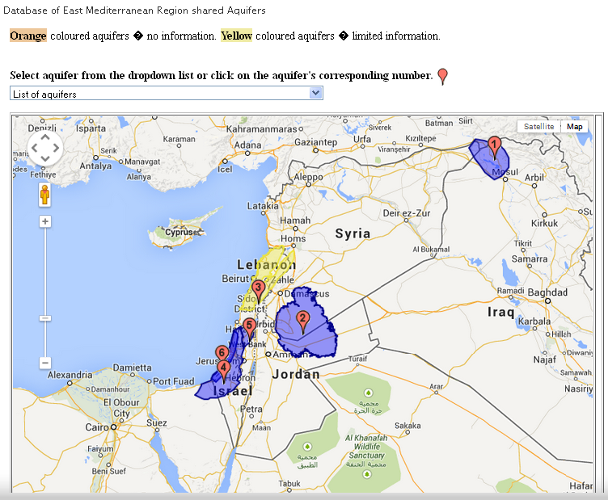
INWEB’s geoinformation databases
Shared Aquifers in SEE
Shared Surface Waters in SEE
Shared Aquifers in N. Africa
Shared Aquifers in the Middle East

Slide 8
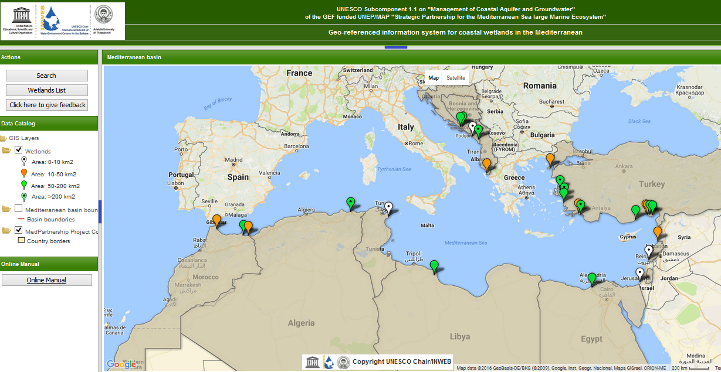
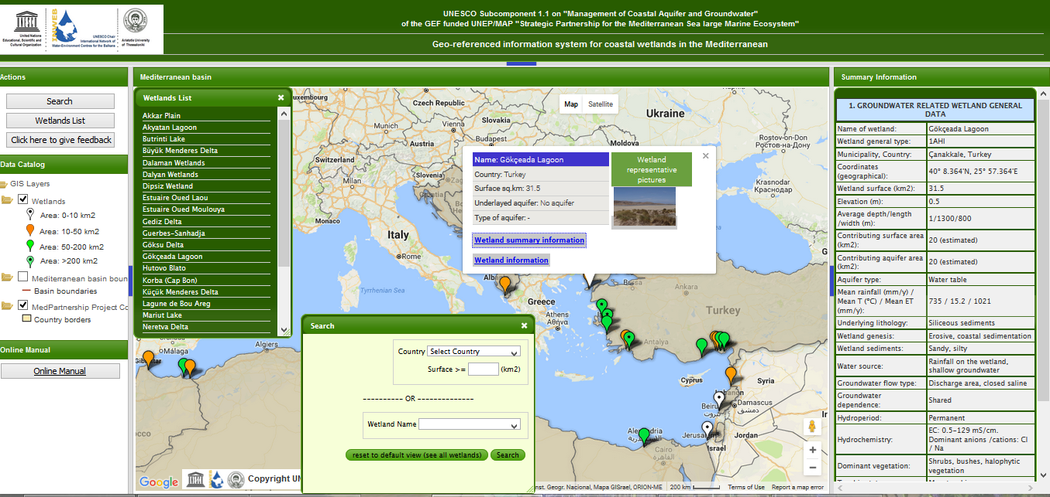
NEW OPEN SOURCE TECHNNOLOGIES IN GEOINFORMATION SYSTEMS

Slide 9
MANAGEMENT OF COASTAL AQUIFER AND GROUNDWATER
MedPartnership Programme /
UNESCO-IHP sub-component on coastal aquifers and groundwater
Activity 1.1.1. Assessment of the Risks and Uncertainties relating to Mediterranean coastal aquifers
Activity 1.1.2. Regional Actions for Coastal Aquifer Management.
Activity 1.1.3. Legislative, policy and institutional reforms for Coastal Aquifer Management
Activity 1.1.4 Spatial technology application
http://www.inweb.gr/mcag/

Slide 10
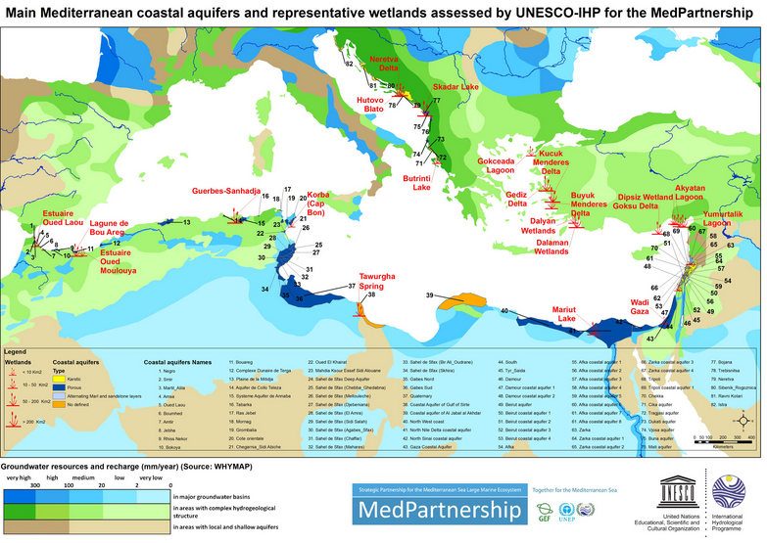

Slide 11
Inventory of transboundary aquifers in Africa
Knowledge, science, technology and innovation (STI): the new Agenda recognizes the importance of fully harnessing STI and Information and Communication Technologies (ICT) for sustainable development.

Slide 12
Mathematical modelling of hydrological and environmental phenomena
In order to address IWRM, UNESCO initiated, in the frame of IHP, the HELP global programme, aiming to reducing the gaps between Hydrology, Environment, Life and Policy (HELP)
The UNESCO/HELP programme established a global network of experimental basins with the aim of exchanging experience on how to apply the IWRM framework by linking hydrology and policy issues.
The Mesta/Nestos case study
THEME 1: WATER-RELATED DISASTERS AND HYDROLOGICAL CHANGE
Focal Area 1.2: Understanding coupled human and natural processes

Slide 13
Modeling Coupling for the
Integrated Water Resources Management
Climate change
models
Hydrological
data
Sediment transport models
Climatic
data
Hydrology model
(Runoff? Quality? Aquifers?)
Economic models
Reservoirs’
simulation
Open MI
….
Agriculture modeling
DSS tools
IWRM

Slide 14
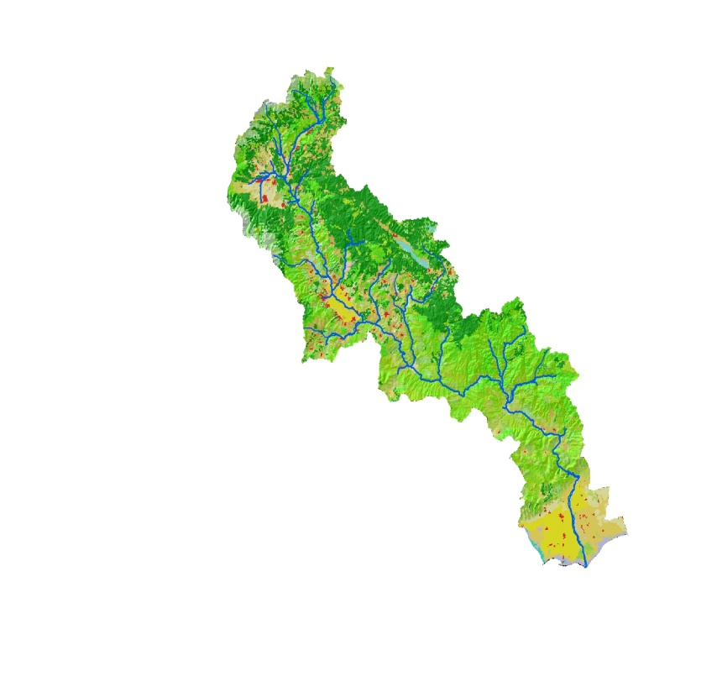
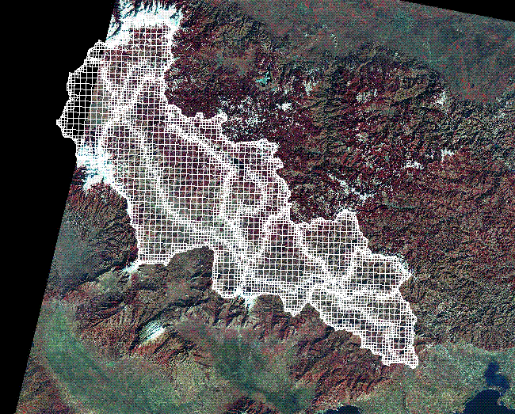
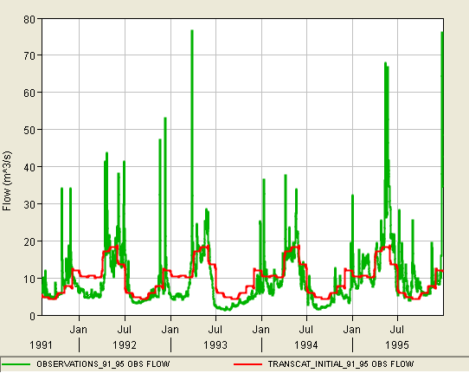
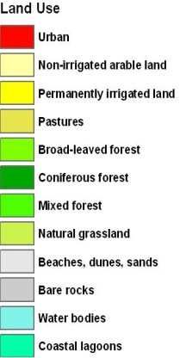
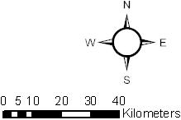
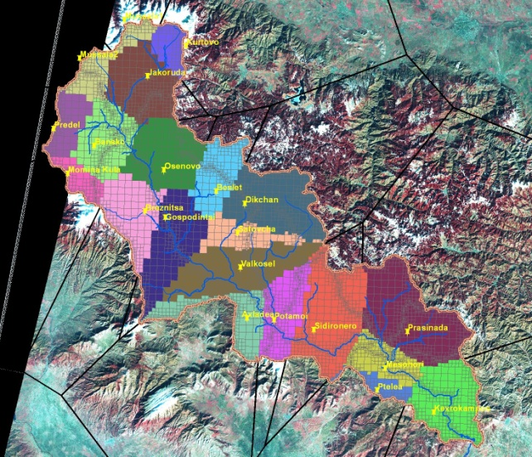
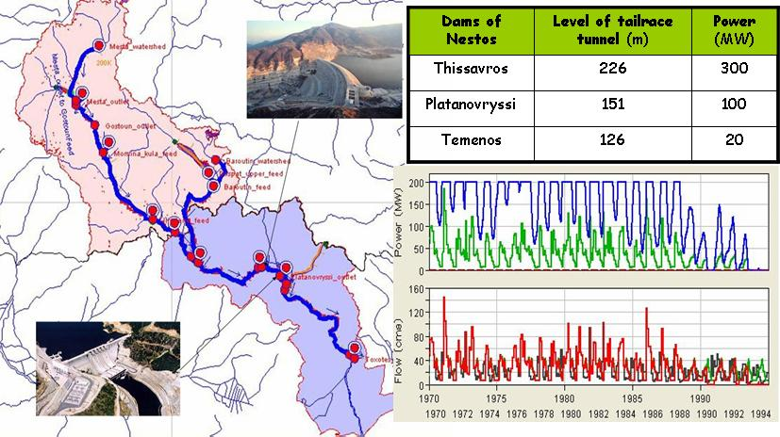
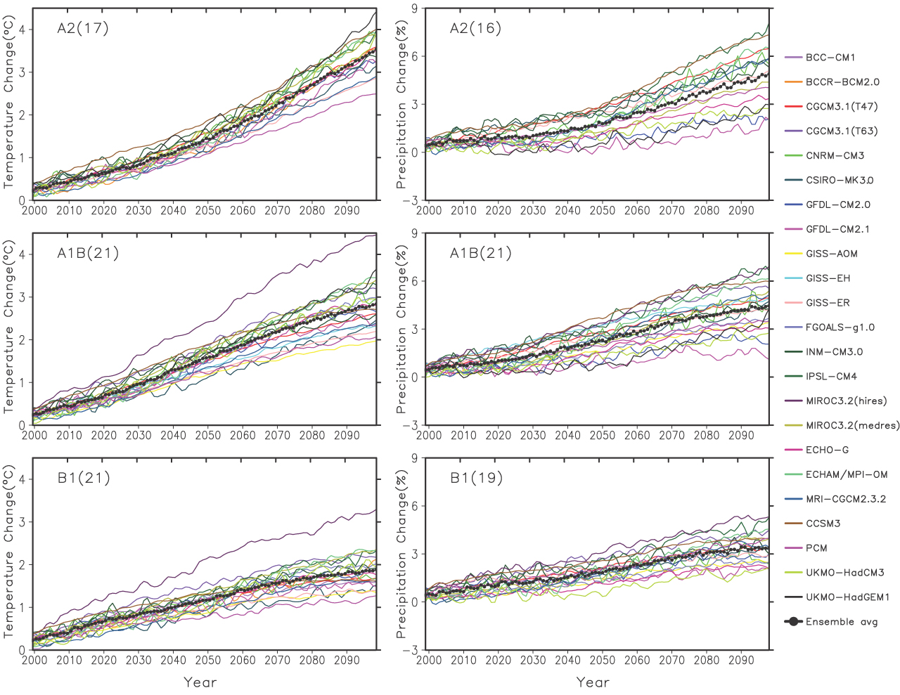
Geographic Information Systems - GIS
Hydrologic modelling
Meteorological data
Reservoir simulation
Climate change models

Slide 15
Environmental and hydrologic education
Tempus project EU 511095: Water Related Advanced Training and Education for Regional Needs in Mahgreb (WATER) (finalized in 2015)
EU Erasmus + Programme - Capacity building in higher education (Call EAC/A04/2014) under the accepted programme: Trans-Regional Environmental Awareness for Sustainable Usage of Water Resources (TREASURE-WATER). Application Ref. Num. 561775-EPP-1-2015-1-DE-EPPKA2-CBHE-JP
EU Erasmus + Programme - Capacity building in higher education (Call EAC/A04/2014) under the accepted programme: Regional PhD School based on Innovative HydroPlatform in Water and Environment to Enhance MAGhreb Inter-Research Centres. Application Ref. Num. 561750-EPP-1-2015-1-MA-EPPKA2-CBHE-JP
THEME 6: WATER EDUCATION, KEY FOR WATER SECURITY
Focal Area 6.5 – Education for transboundary water cooperation and governance.

Slide 16
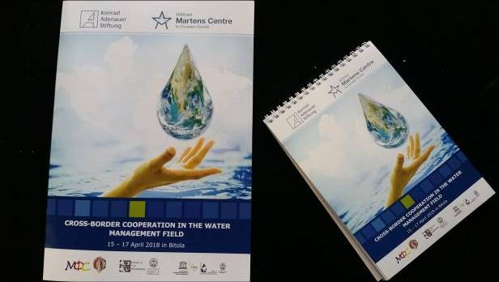
Environmental and hydrologic education
Organization of 3 Regional Student Workshop on “Cross-Border Cooperation in the Water Management Field” by Konrad-Adenauer-Stiftung, Skopje, Wilfried Martens Centre for European Studies, Brussels and UNESCO Chair/INWEB, Thessaloniki.
Aim: Bringing together undergraduate students of the Dept. of Civil Engineering, AUTh, Greece, and the Dept. of Mechanical Engineering, Ss. Cyril and Methodius University, North Macedonia, to work together and cope with transboundary issues as:
Waste Water Management of the River Vardar/Axios
Waste Water Management of the Dojran/Doirani Lake
Transboundary cooperation
Ohrid, North Macedonia, 4-7 April 2019
THEME 6: WATER EDUCATION, KEY FOR WATER SECURITY
Focal Area 6.5 – Education for transboundary water cooperation and governance.

Slide 17
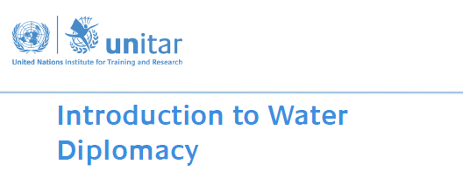
Education: Hydro-Diplomacy
Learning objectives
Describe major contemporary stressors influencing freshwater availability and their impact on achieving national security goals;
Identify water's potential for conflict and identify some of the world’s main water "hotspots";
Recognize water’s cooperation potential and the benefits to be drawn from collaborative transboundary water management between state actors;
THEME 6: WATER EDUCATION, KEY FOR WATER SECURITY
Focal Area 6.1 - Enhancing tertiary water education and professional capabilities in the water sector.

Slide 18
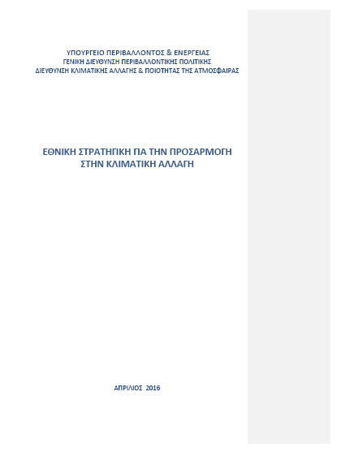
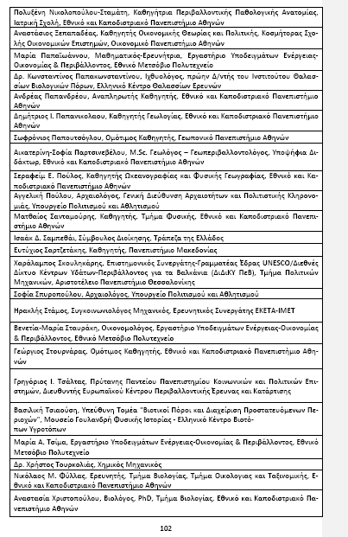
Climate change impacts on hydrology
National Climate Change Adaptation Strategy (NCCAS)
With the aim to address the impact of climate change at country level and add on the experience on economic and other impacts of climate change, the draft text of the National Climate Change Adaptation Strategy (NCCAS) has been submitted in December 2015 to the Ministry of Environment, Energy and Climate Change and put up for public consultation.
The final document was launched in April 2016 (in greek)

Slide 19
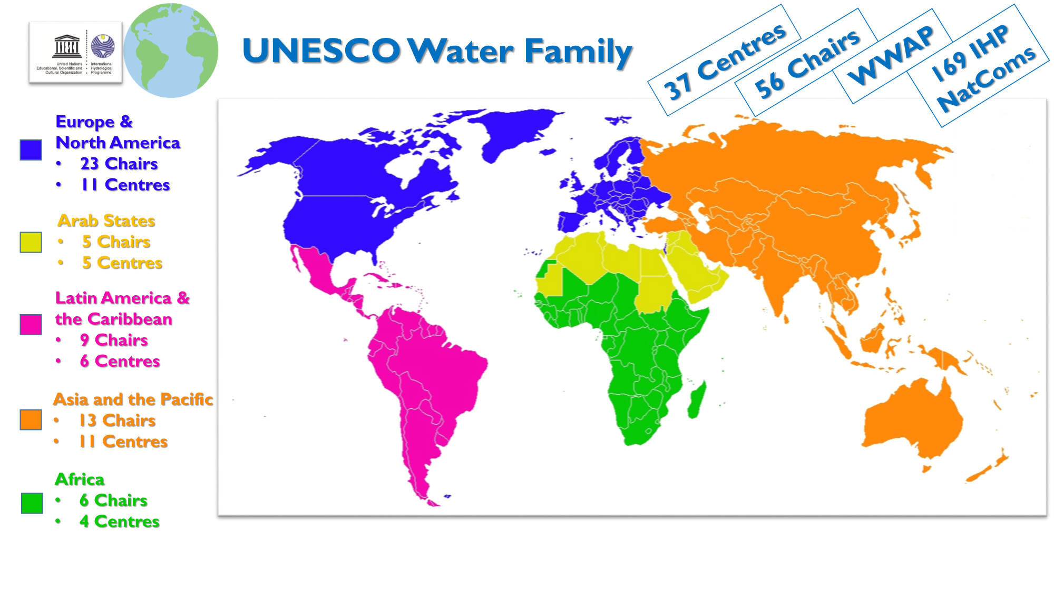
http://www.inweb.gr

Slide 20
Thank you for your attention!

